Slide 1

Machine Learning for Classification and Regression Tasks

Slide 2


Slide 3
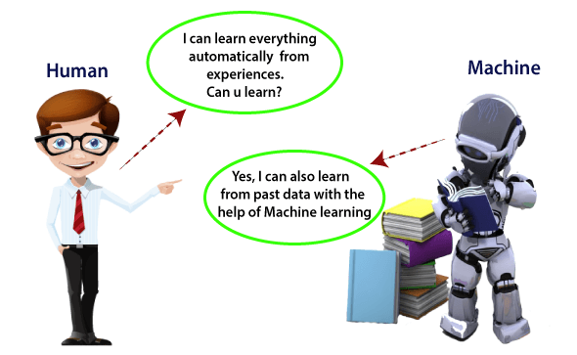

Slide 4

Project Contents
Introduction
Data Description
Data Preprocessing
Model Selection
Model Training and Evaluation
Conclusion

Slide 5


subtitle

Slide 6
INTRODUCTION
Objective:
The goal of this analysis is to utilize machine learning techniques to predict the presence or absence of heart disease in patients based on their medical data. By leveraging various classification algorithms, we aim to build and evaluate models that can assist in early diagnosis and decision-making in healthcare.
Analysis Goals:
Model Development: Implement and train several classification models to predict heart disease.
Performance Evaluation: Compare model performance using metrics like accuracy, precision, recall, and F1-score.
Feature Importance: Identify key features that significantly impact the prediction of heart disease.
Visualization: Generate visualizations to better understand model performance and feature relationships.
By achieving these goals, we aim to improve our understanding of heart disease prediction and enhance the accuracy of diagnostic tools in healthcare.

Slide 7
Data Description
Features
age: Age of the patient (numeric)
sex: Gender (1 = Male, 0 = Female)
cp: Chest pain type (categorical, 4 types)
trestbps: Resting blood pressure (numeric, mm Hg)
chol: Serum cholesterol level (numeric, mg/dl)
fbs: Fasting blood sugar (> 120 mg/dl, 1 = true, 0 = false)
restecg: Resting electrocardiographic results (categorical)
thalach: Maximum heart rate achieved (numeric)
exang: Exercise induced angina (1 = yes, 0 = no)
oldpeak: Depression induced by exercise relative to rest (numeric)
slope: Slope of the peak exercise ST segment (categorical)
ca: Number of major vessels colored by fluoroscopy (numeric, 0-3)
thal: Thalassemia (categorical, 3 = normal, 6 = fixed defect, 7 = reversible defect)
target: Presence of heart disease (1 = Yes, 0 = No)
Number of Instances: 1025
Number of Features: 13
Data Types:
Numeric, Categorical
Data Summary:

Slide 8
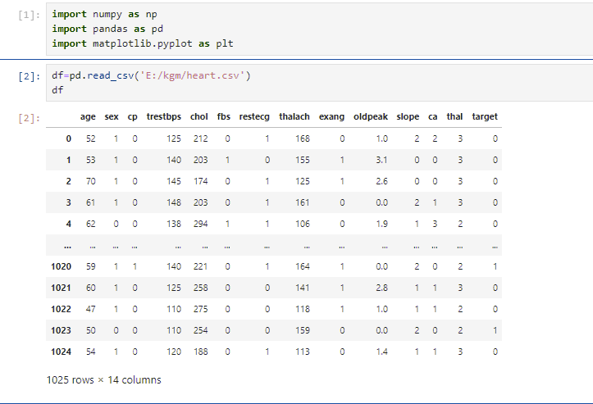
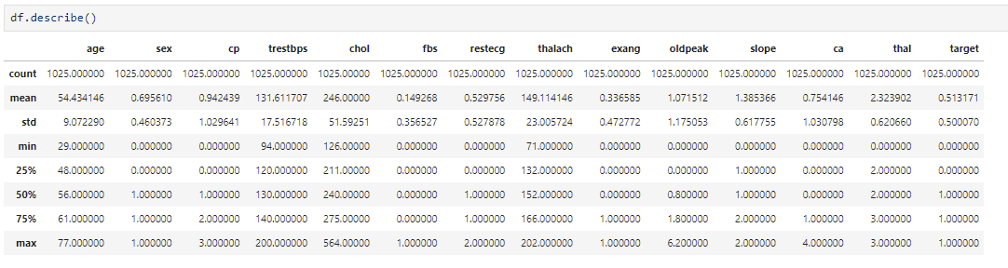

Slide 9
Data Preprocessing
Handling Missing Values
Outlier Detection & Correction
Improving Quality of Data

Slide 10
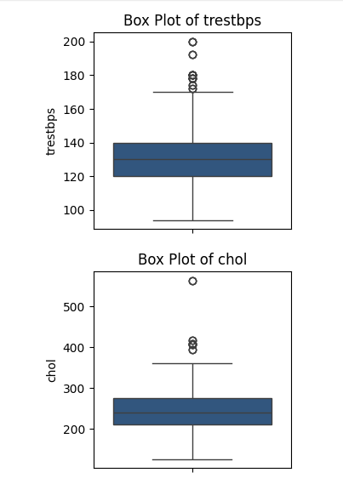
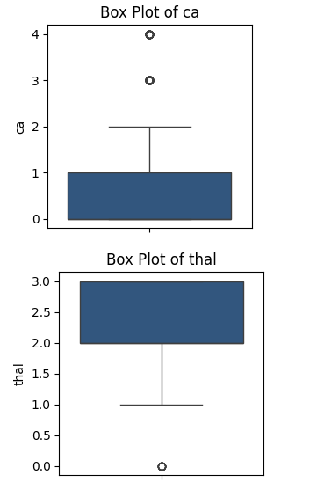
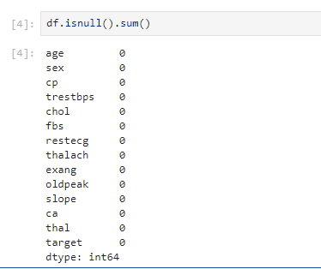
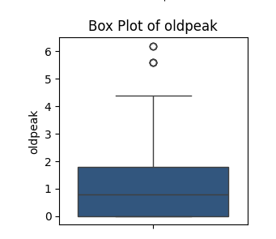
Checking For Missing Values in the Data Set
Outlier Detection Using Box plots

Slide 11
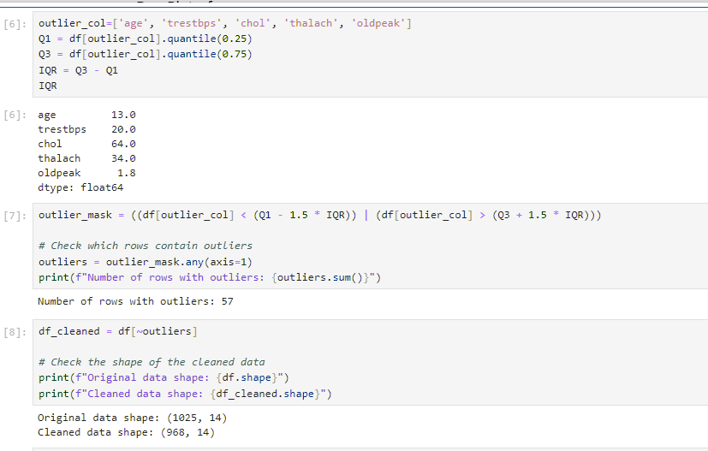
Improving Quality of Data

Slide 12
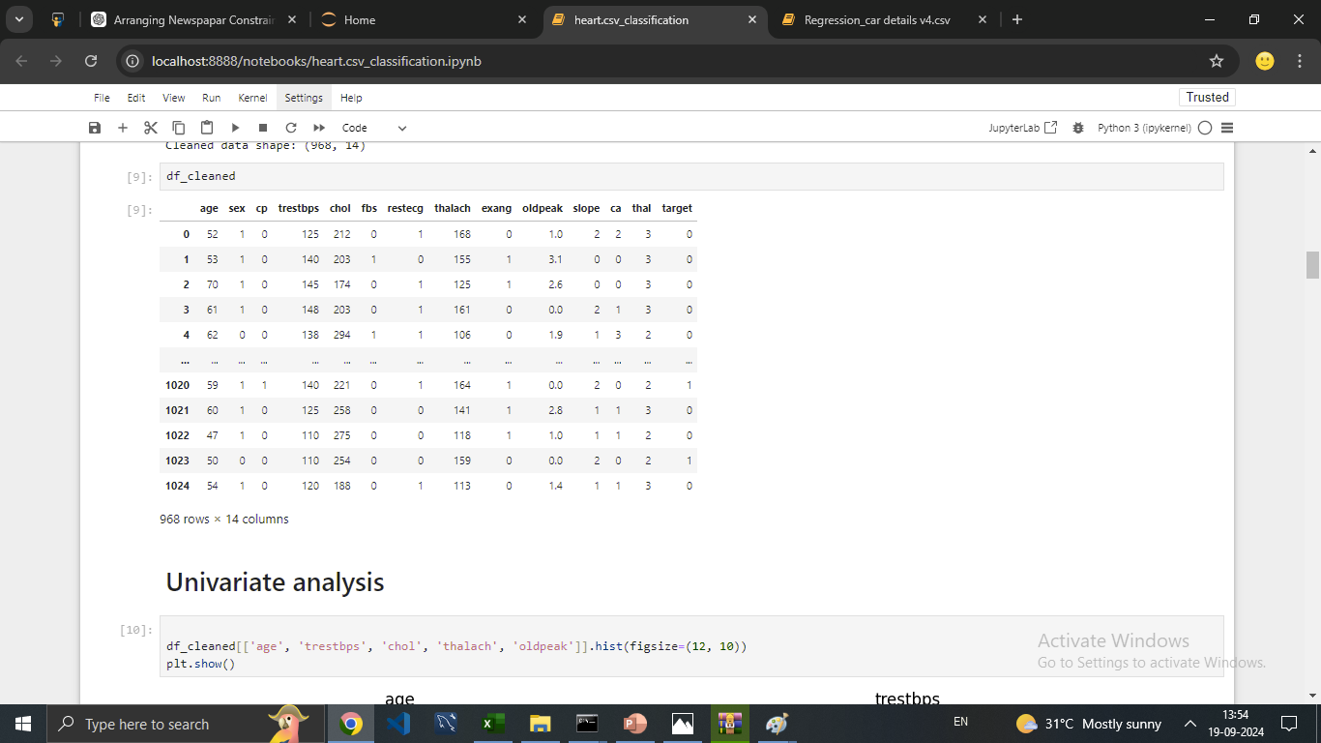
Cleaned Data Set

Slide 13
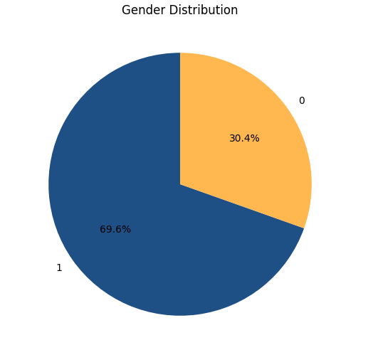
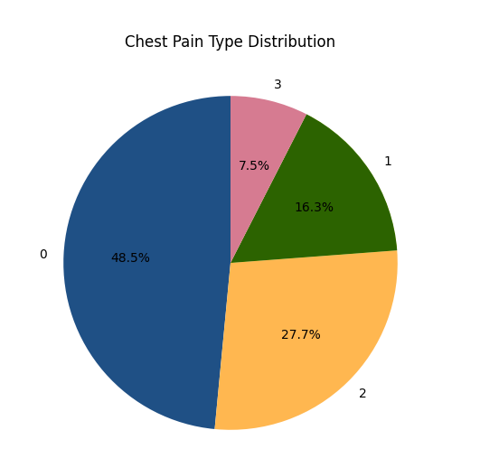
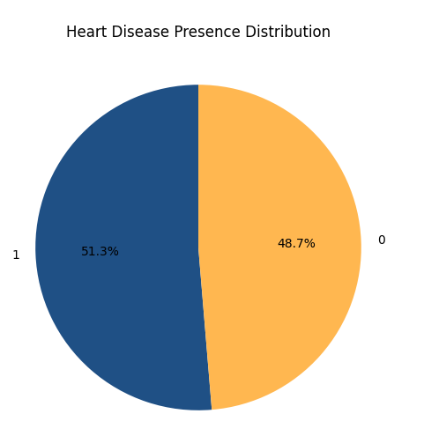
Univariate Analysis (categorical columns)
1 = Male 0 = Female | Different types of chest pain are encoded as numerical values 0 = Typical Angina 1 = Atypical Angina 2 = Non-Anginal Pain 3 = Asymptomatic | This indicates whether a patient has heart disease. It is encoded as: 0 = No heart disease 1 = Heart disease detected

Slide 14
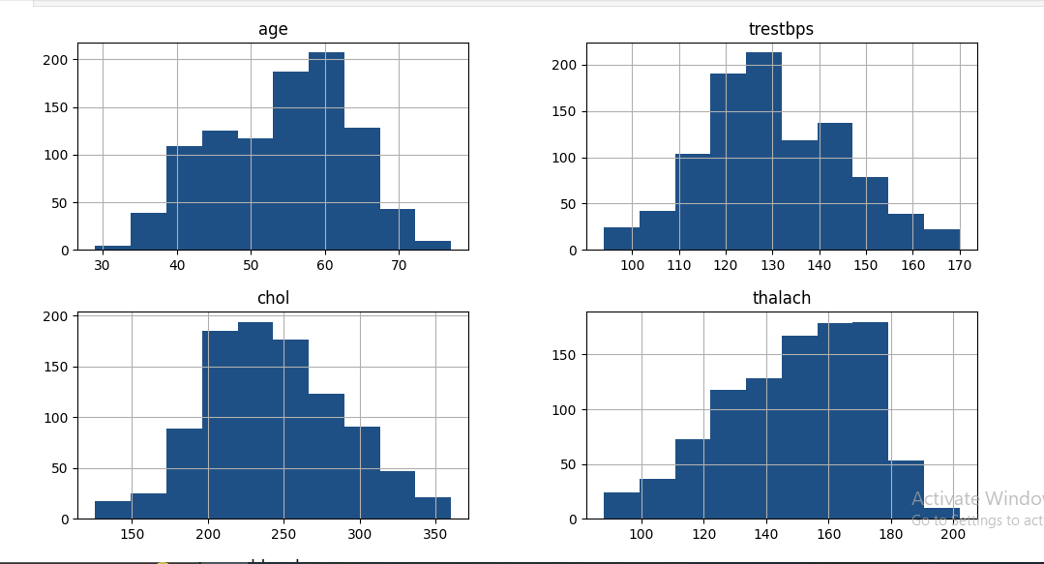
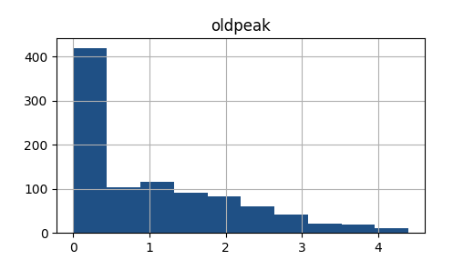
Univariate Analysis (Numerical Columns)

Slide 15
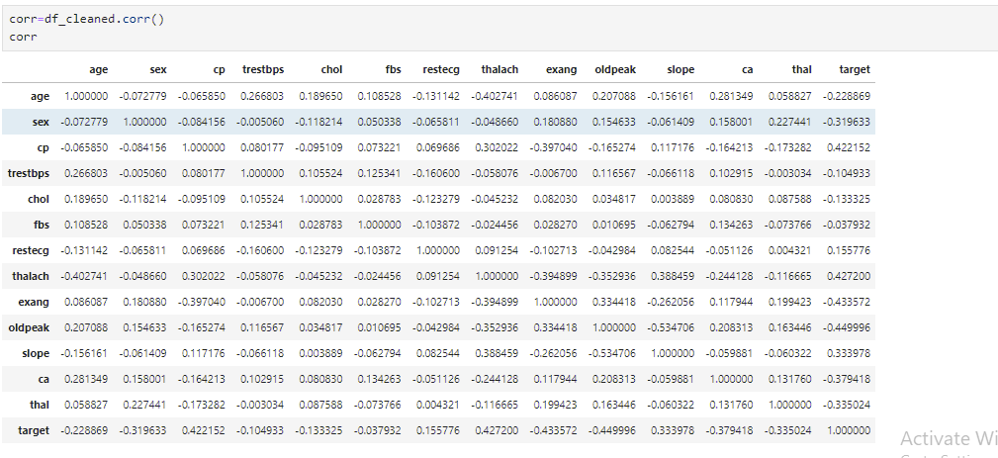
Correlation Matrix

Slide 16
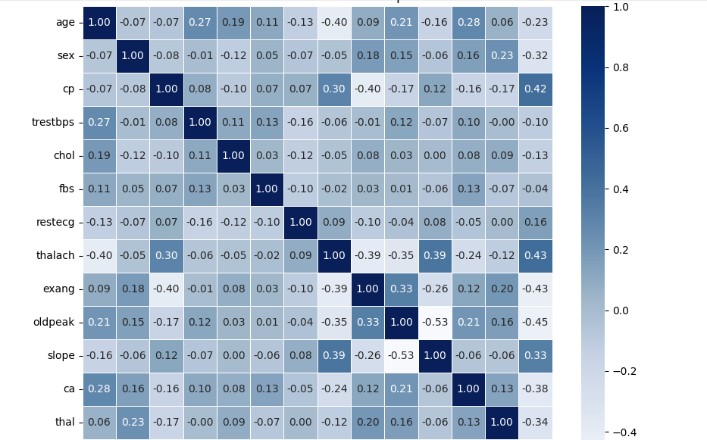
Heat Map using Correlation Matrix

Slide 17
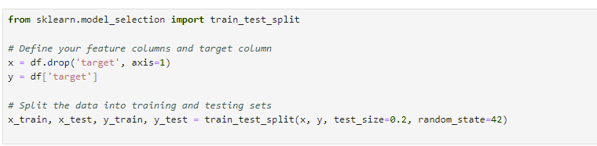
Model Selection
we applied various machine learning models to predict the presence of heart disease based on the features of the data set. Our main goal is to identify best performing model for accurate prediction.
Logistic Regression
Random Forest
SVC
KNN
Data Splitting
To prepare the dataset for modeling, we need to separate the features (independent variables) from the target (dependent variable).

Slide 18
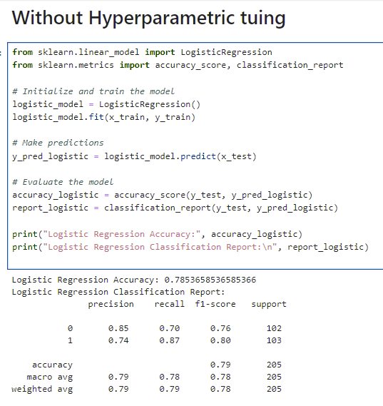
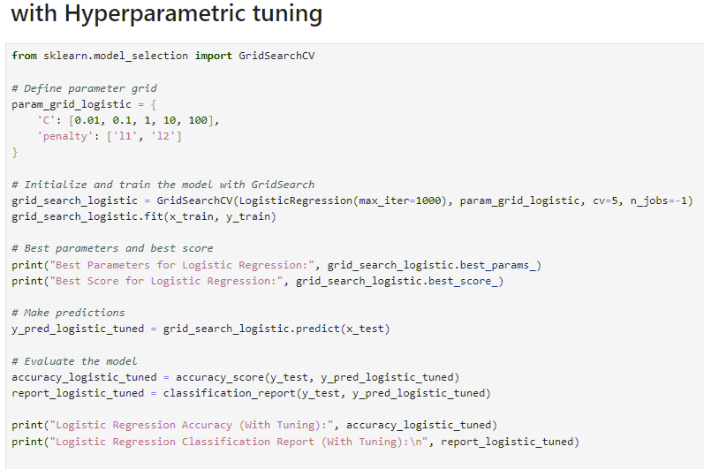
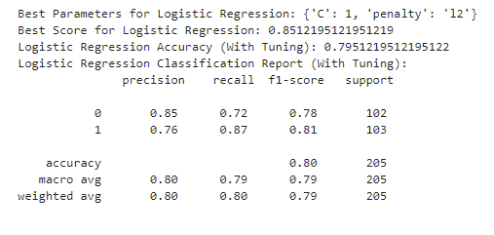
Logistic Regression

Slide 19
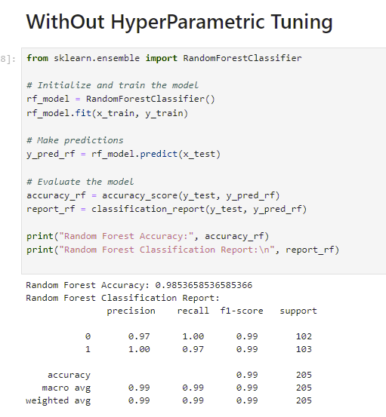
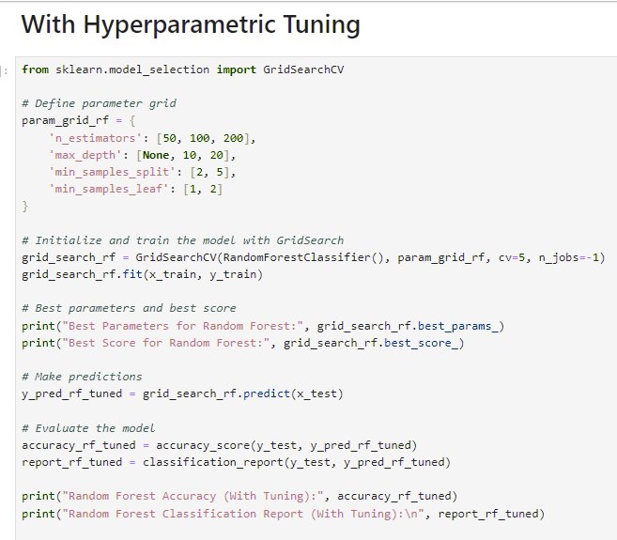
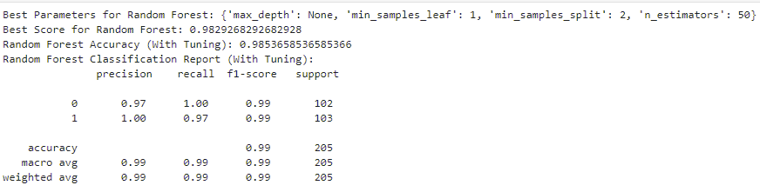
Random Forests

Slide 20
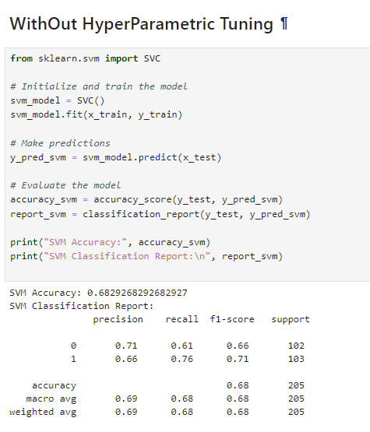
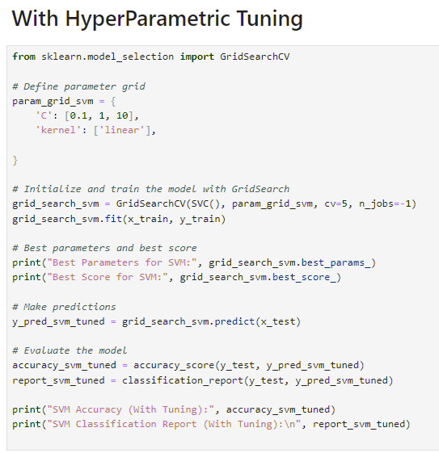
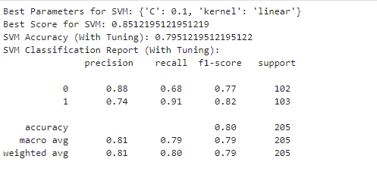
SVC

Slide 21
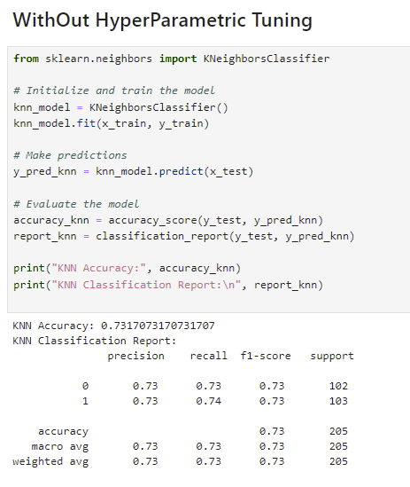
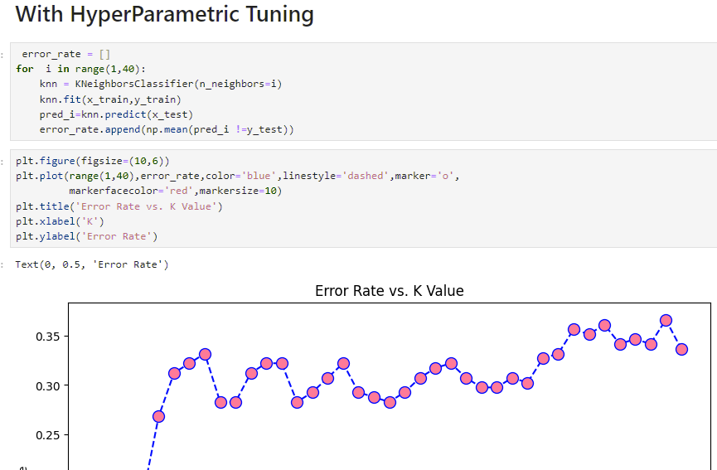
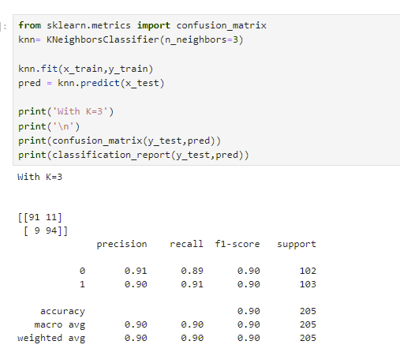
KNN

Slide 22
Conclusion
RandomForestClassifier: Accuracy: 99%
K-Nearest Neighbors (KNN) Classifier: Accuracy: 90%
Linear Regression: Accuracy: 80%
Support Vector Classifier (SVC): Accuracy: 79%
The RandomForestClassifier emerged as the superior model for heart disease prediction, with an impressive accuracy of 99%. This indicates its robustness and effectiveness in capturing the complex patterns in the dataset. The KNN Classifier also performed well but fell short of the RandomForest’s accuracy. Linear Regression and SVC, while providing valuable insights and serving as baseline models, demonstrated lower performance. This analysis highlights the importance of selecting advanced, ensemble-based methods like RandomForest for achieving optimal predictive accuracy in complex classification tasks.

Slide 23


Slide 24
INTRODUCTION
Objective:
The goal of this analysis is to use regression techniques to predict the price of cars based on various factors such as make, model, year, kilometers driven, fuel type, engine capacity, and other relevant features. By building and evaluating different regression models, we aim to identify the key factors that influence car prices and develop a model that provides accurate price predictions for used cars.

Slide 25
Data Description
Features
Make: The brand of the car (e.g., Honda, Maruti Suzuki, Toyota).
Model: The specific model of the car.
Price: The selling price of the car (target variable).
Year: The manufacturing year of the car.
Kilometer: The total kilometers the car has been driven.
Fuel Type: The type of fuel used (e.g., Petrol, Diesel)
Fuel Type: The type of fuel used (e.g., Petrol, Diesel).
Transmission: The type of transmission (Manual or Automatic).
Location: The city where the car is being sold.
Drivetrain: Whether the car is Front Wheel Drive (FWD) or (RWD).
Owner: The number of previous owners (First, Second, etc.).
Seller Type: The type of seller (e.g., Corporate, Individual).
Engine: The engine capacity of the car in cubic centimeters (cc)
Fuel Tank Capacity: The maximum fuel the car’s tank can hold, measured in liters.
Number of Instances: 2059
Number of Features:20
Data Types:
Numeric, Categorical
Data Summary:

Slide 26
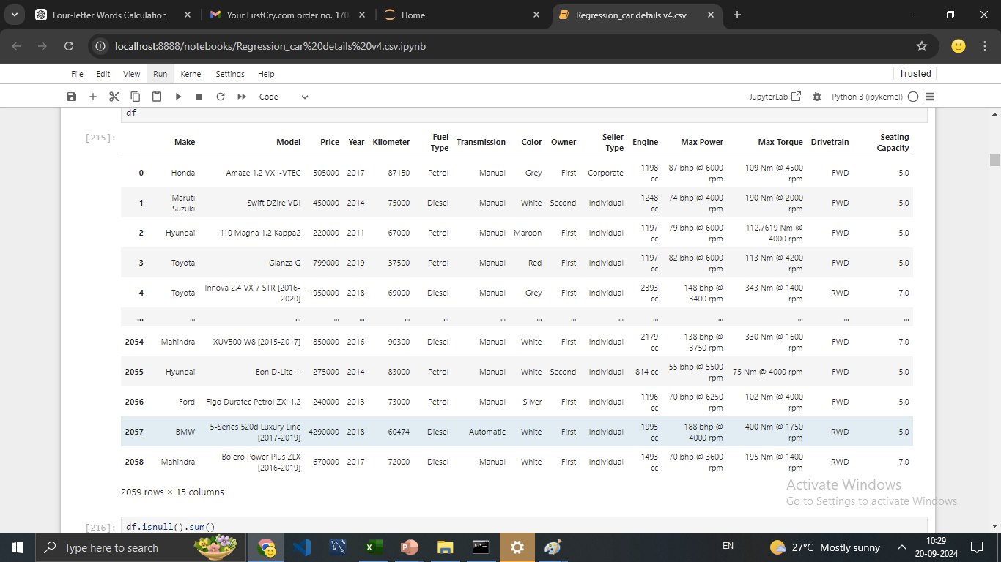

Slide 27
Data Preprocessing
Handling Missing Values
Outlier Detection & Correction
Improving Quality of Data

Slide 28
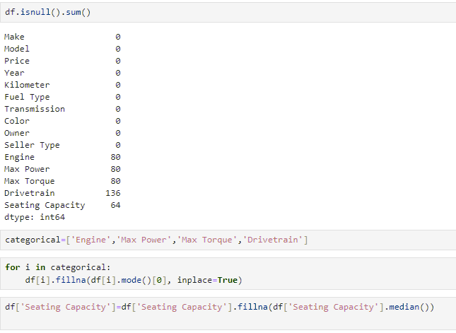
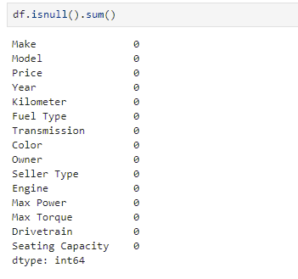
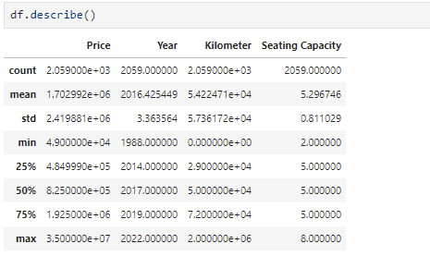
Handling Missing Values
Statistical Summary
After Correction

Slide 29
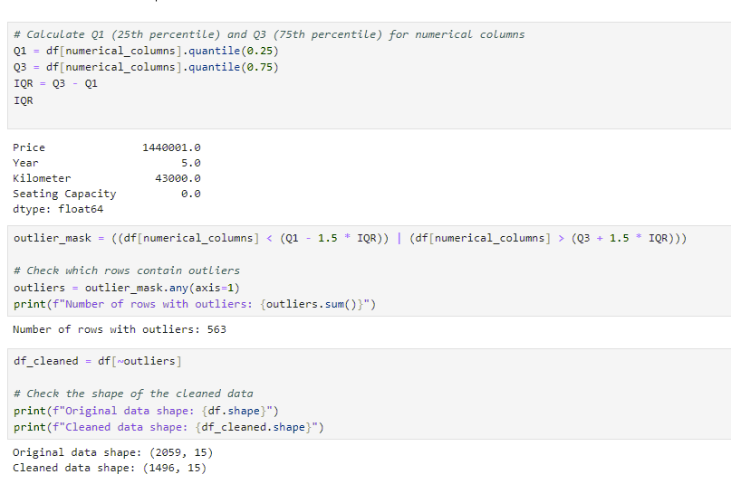
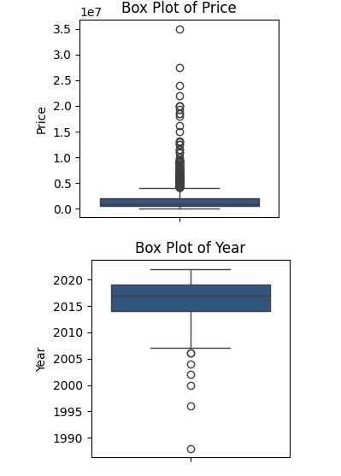
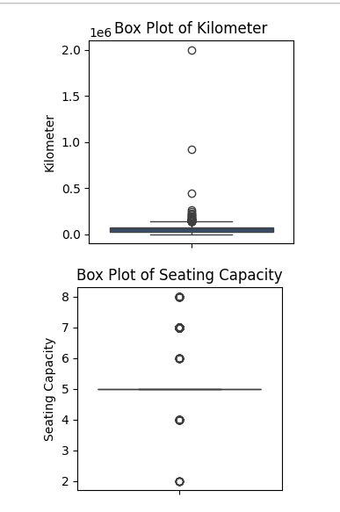
Outlier Detection & Correction
Improving Quality of data

Slide 30
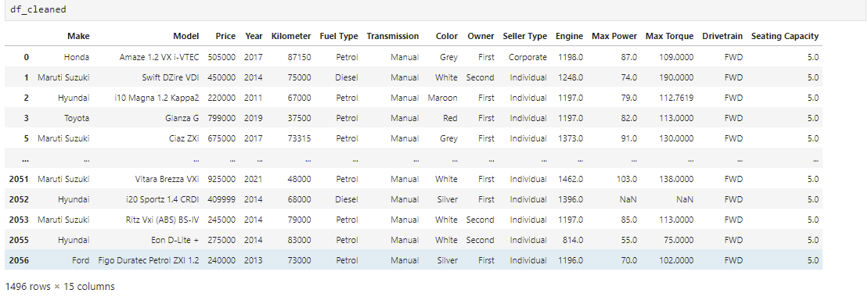
Cleaned Data Set

Slide 31
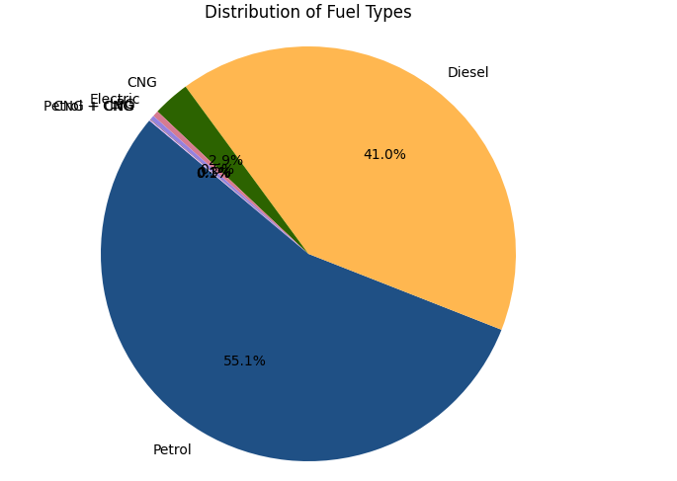
Univariate Analysis using Pie Chart

Slide 32
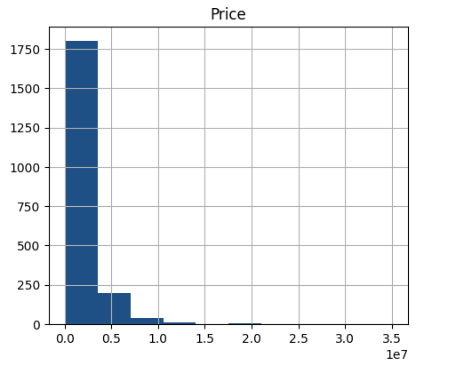
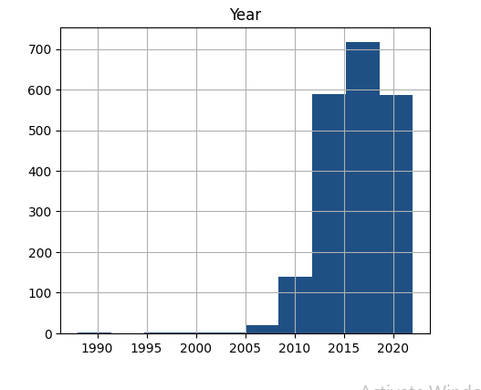
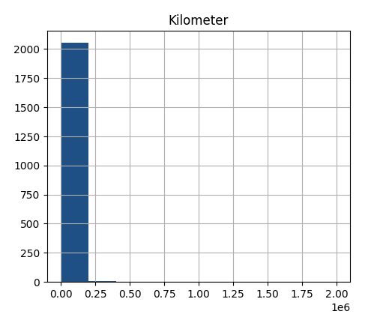
Univariate Analysis using histogram
The dataset consists mostly of cars priced below a certain range (as indicated by the first bar), with fewer entries for higher-priced cars. | The bars are more concentrated between the years 2010 and 2020, meaning most of the cars in the dataset are relatively new, built in the last 10-15 years. | majority of the cars having travelled fewer kilometres. The histogram shows that most cars have covered fewer distances, and there are very few cars with high mileage.

Slide 33
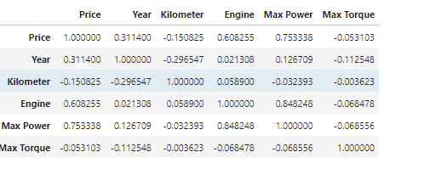
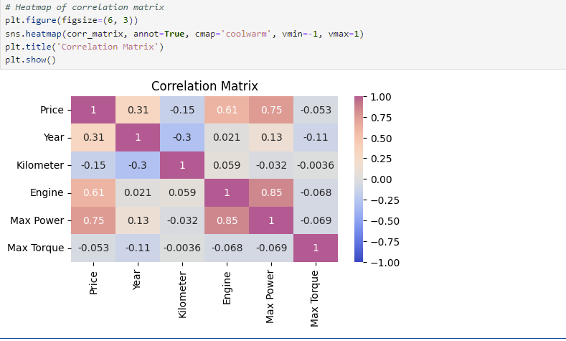
Correlation Matrix and Heat map

Slide 34
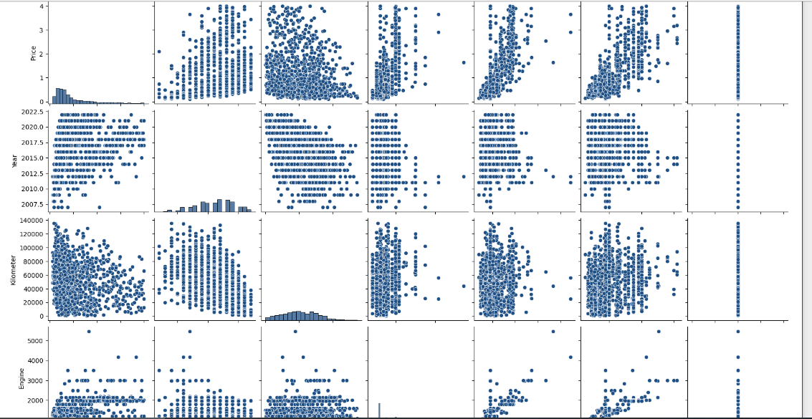
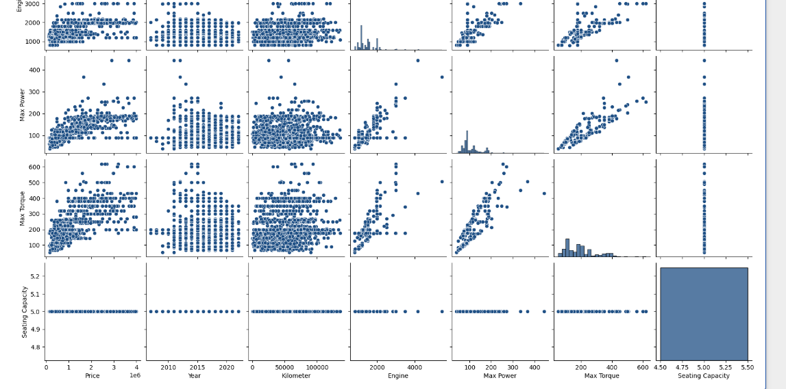
Pairplot

Slide 35
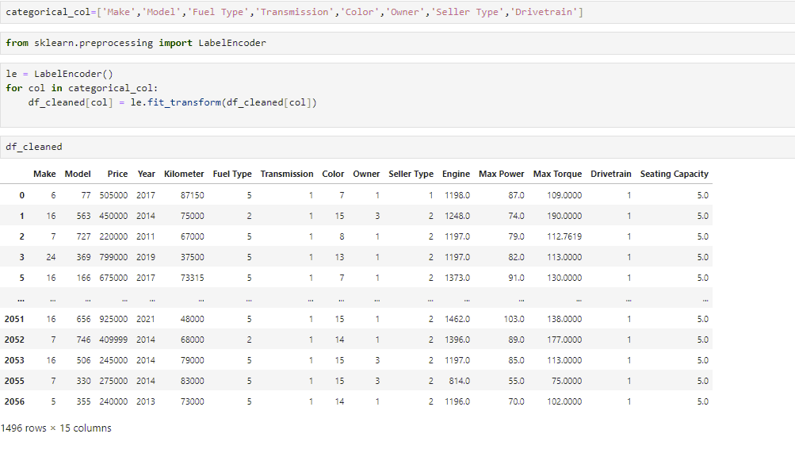
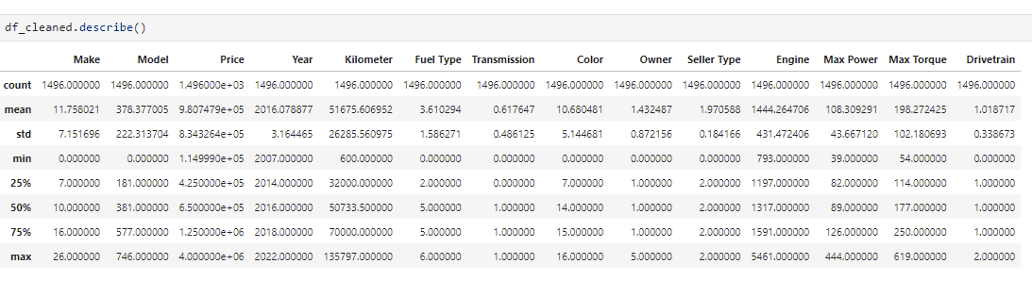
Label Encoding
Statistical Summary Showing Variations After Data Cleaning and Label Encoding

Slide 36
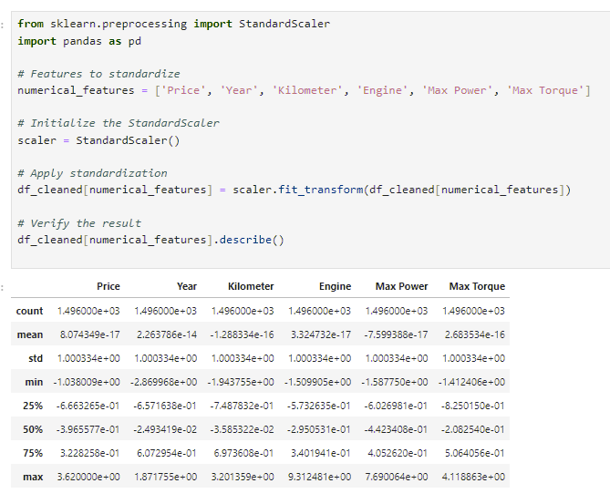
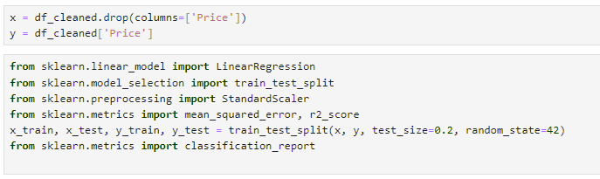
To prepare the dataset for modeling, we need to separate the features (independent variables) from the target (dependent variable).
Feature Scaling Using Standard Scaler for Normalized Data Distribution

Slide 37
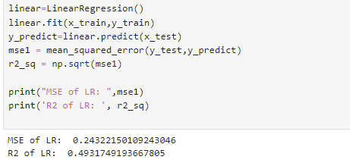
"Model Selection for Regression Analysis
For predicting car prices, the following machine learning regression models were applied:
Linear Regression
Ridge Regression
Lasso Regression
Random Forest Regressor
Support vector Regressor
Linear Regression

Slide 38


Ridge & Lasso Regression

Slide 39




Random Forest Regressor

Slide 40


Support vector Regressor

Slide 41
Conclusion of Regression Analysis
Linear Regression (LR):
MSE: 0.2432
R²: 0.4932
Ridge Regression:
Test MSE: 0.2427 (Best MSE)
Lasso Regression:
Test MSE: 0.2725
Random Forest Regressor (With Hyperparameter Tuning):
MSE: 0.0875 (Best MSE overall)
R²: 0.92 (Best R² overall)
Support Vector Regressor (SVR):
Untuned R²: -0.0997, MSE: 1.1106
Tuned R²: 0.1740, MSE: 0.8342
The Random Forest Regressor without tuning provided the best MSE and R², outperforming the other models.

Slide 42


